Slide 1
Internship Presentation Summer 2025
Neil Maushard

Slide 2

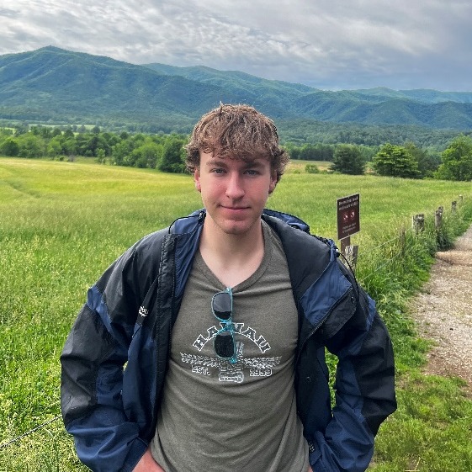
Introduction
Mechanical Engineering Student at the University of Illinois
Minoring in Electrical Engineering
Personal Interests
Camping and Hiking
Weightlifting
Cooking

Slide 3
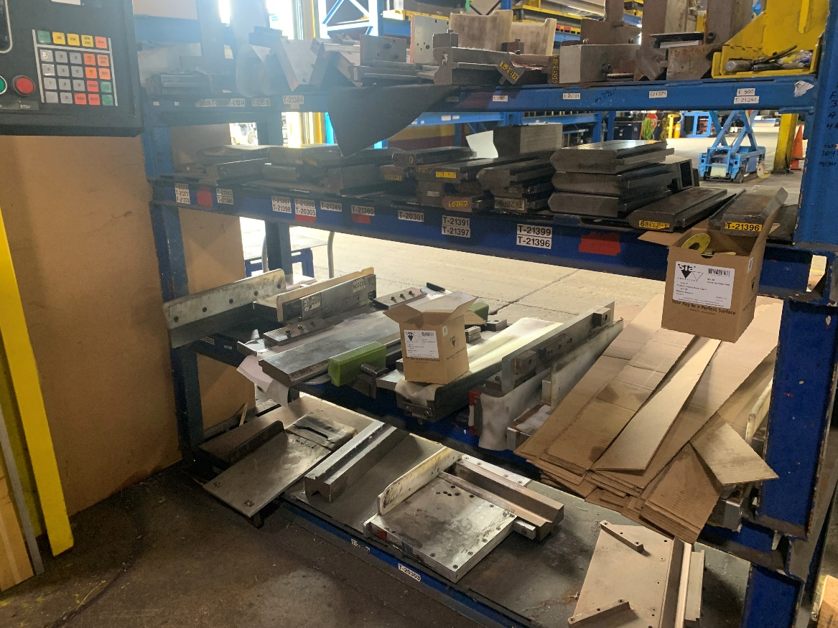
Press 19 Die Rack
Problem: Die rack is unorganized and is an ergonomics/safety issue

Slide 4
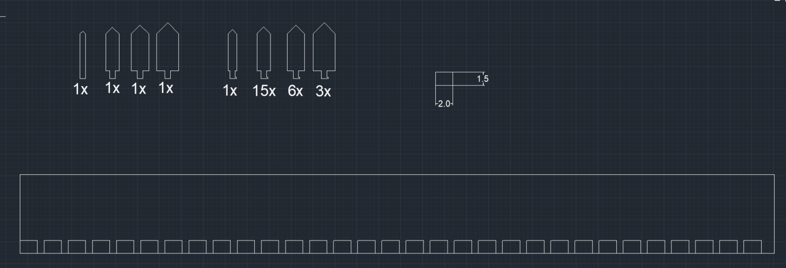
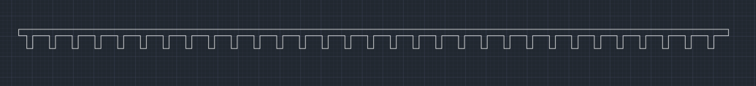
Press 19 Die Rack
Measured dies, designed rails to fit them
Determined proper steel tubing and ordered 30 x 2ft
Designed backstop/guide for assembly with proper tolerance

Slide 5
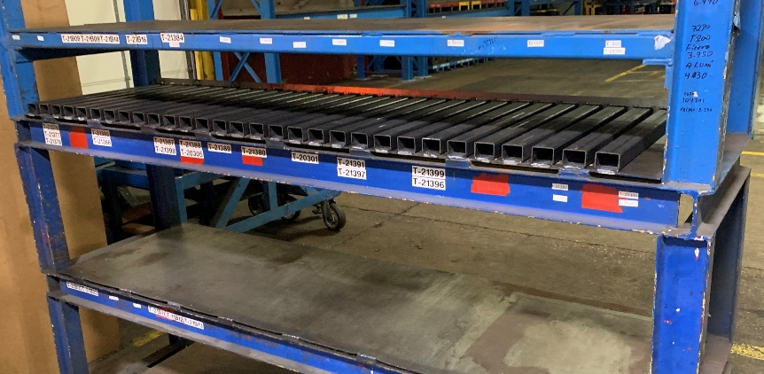
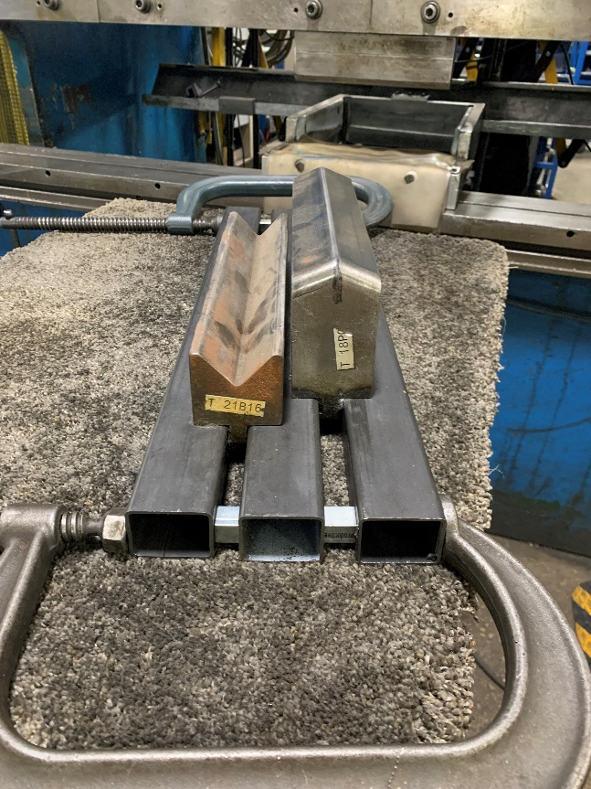
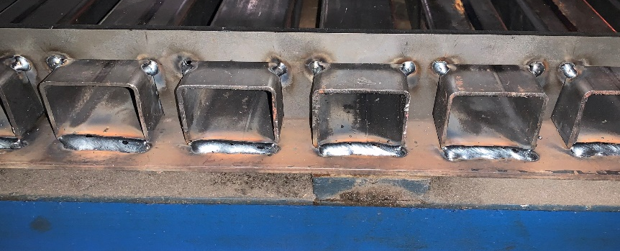
Press 19 Die Rack
Built prototype using thickest dies for POC and operator approval
Emptied and cleaned rack
Welded tubing

Slide 6
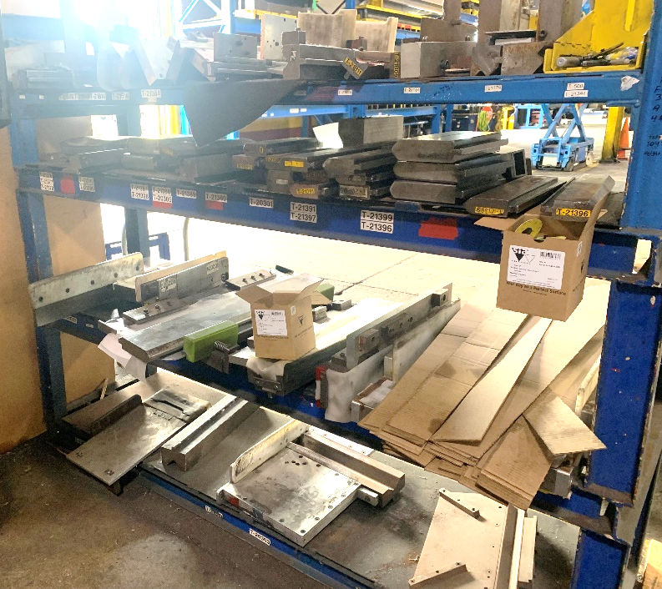
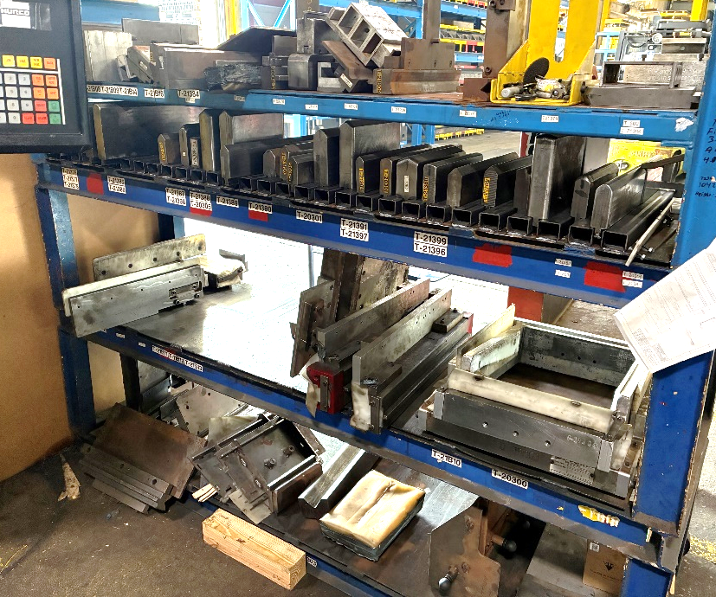
Press 19 Die Rack
Before
After
Future:
Relabel (?)
Lubricate if needed

Slide 7
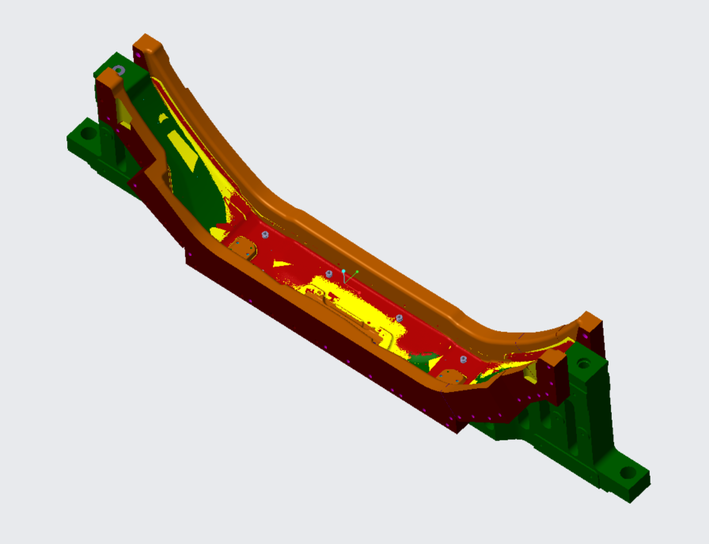
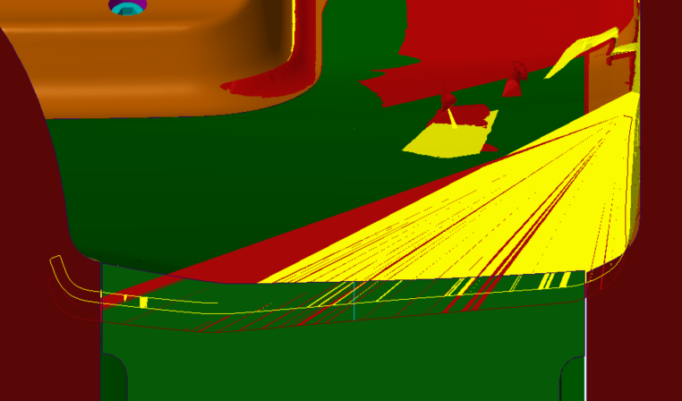
Clad Springback Analysis
Problem: Stainless steel clad’s springback is not well understood
Yellow outline –aluminum bumper
Green border – die surface
Green/orange – die
Red – clad bumper scan
Yellow – aluminum bumper scan
Red outline – clad bumper
Notes:
Explain image 1
Explain image 2 and visual springback and measurement process

Slide 8
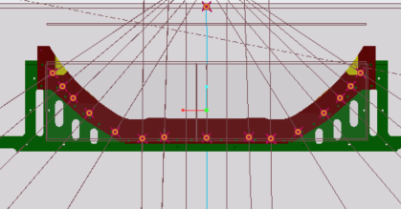
Clad Springback Analysis
Results inconclusive
Expected a flat line to confirm hypothesis
Other confounding variables such as previous operations
Next step is physical experiment
Notes:
Explain graph
– axes
What each point is
Expectation, flat or linear
Strong fit
Previous operations

Slide 9
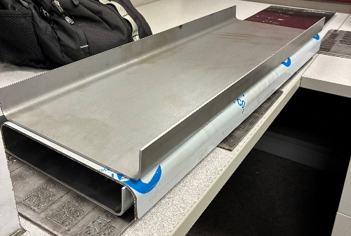
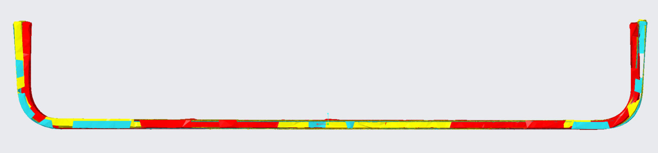
Clad Springback Analysis
Cut and channeled 3 pieces (clad, steel, aluminum) using same program
Discrepancy: steel should be stiffer than aluminum
Measured thickness
Steel: 0.117 in
Aluminum: 0.132 in (including PVC)
Clad: 0.125 in (including PVC)
Try again, ensuring uniform thickness, then rescan
Then bend parts on press 14/15
Blue – steel
Red – clad
Yellow – aluminum
Notes:
Explain initial plan with experiment
Discrepancy
New plan

Slide 10
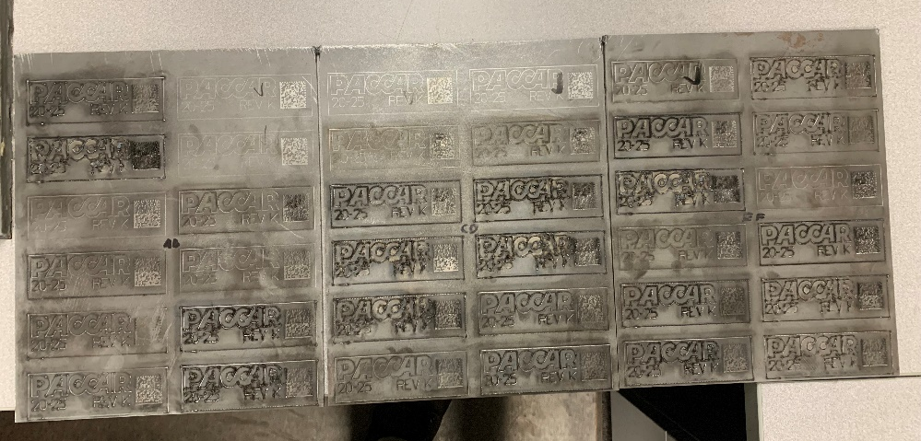
Part Marking
Problem: Mecco part marking leads to many inaccuracies
Solution: Mark parts with laser
Started with steel, which goes through post-processing
Tried many different setting combinations
Power - how much energy is in each laser pulse
Pulses/mm - how often the laser pulses while traveling
Pulse width - how long each pulse is
Results were displeasing (?)
Either look/scan well but too shallow or are deep but don’t scan
Depends on what is required

Slide 11
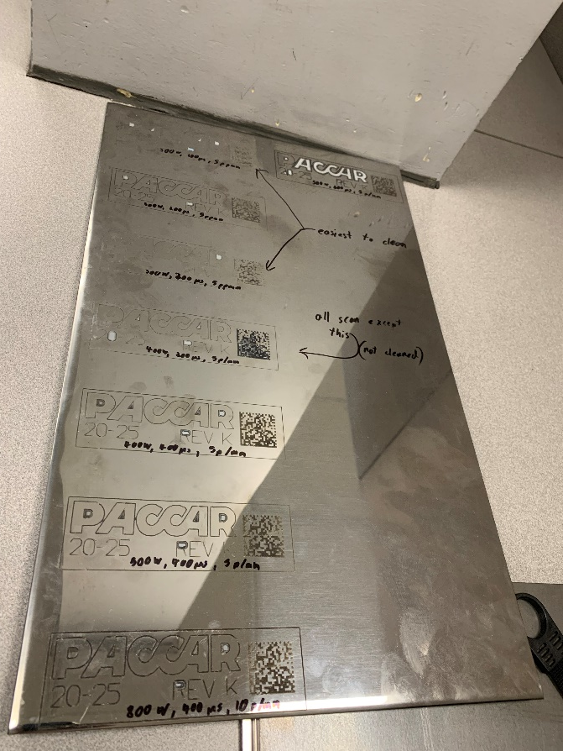
Part Marking
Clad doesn’t go through post-processing
Tried a few combinations
Success! But….
Extra cleaning
Might lead to more clad being run on Bystronic

Slide 12
Part Marking
Moving Forward
Test aluminum
Integrate marking into Bystronic laser programs
Bystronic does not have automatic date updates
Explore engraving with Trumpf laser now that we have Bystronic software
Settings previously determined, but old Trumpf software couldn’t handle barcodes

Slide 13
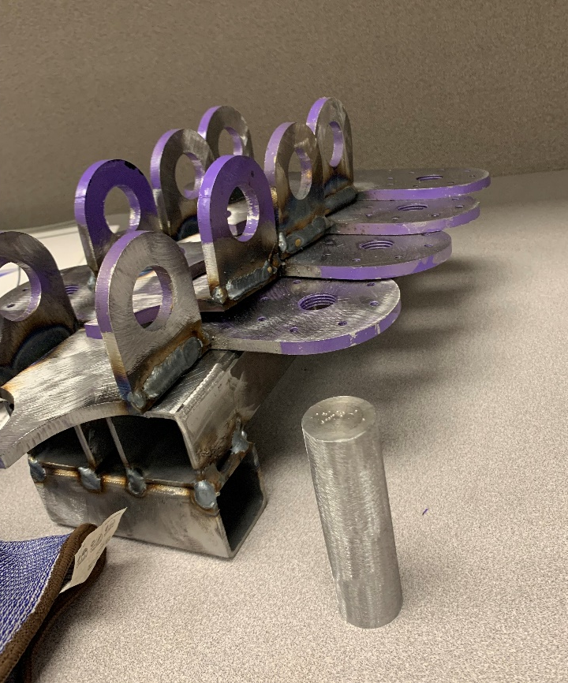
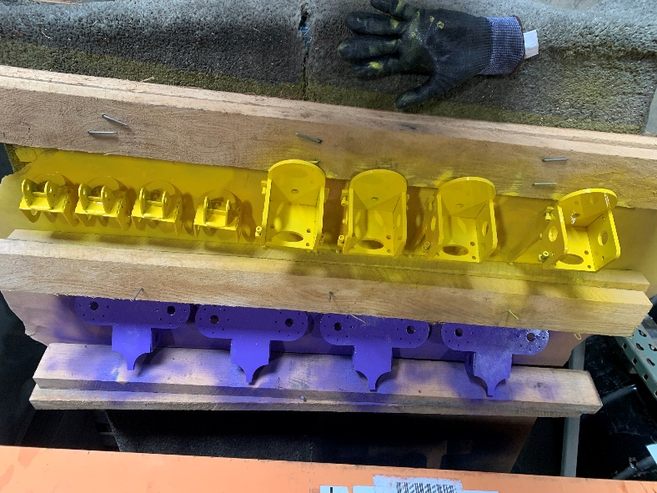
Press 217 Manipulator Heads
New set of vacuum and magnet heads for press 217 manipulators

Slide 14
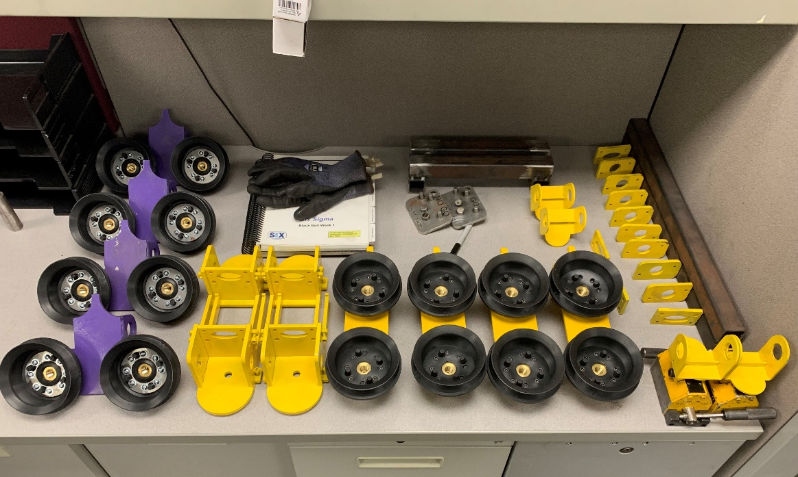
Press 217 Manipulator Heads
4 purple vacuum heads
4 yellow vacuum heads
4 pneumatic magnet heads
2 manual magnet heads
2 extra brackets
Saved ~$30,000 by not buying from GCI

Slide 15
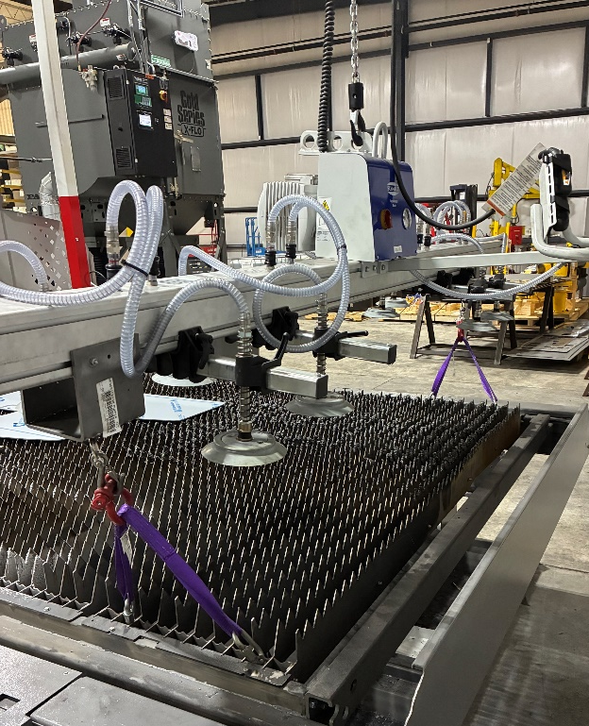
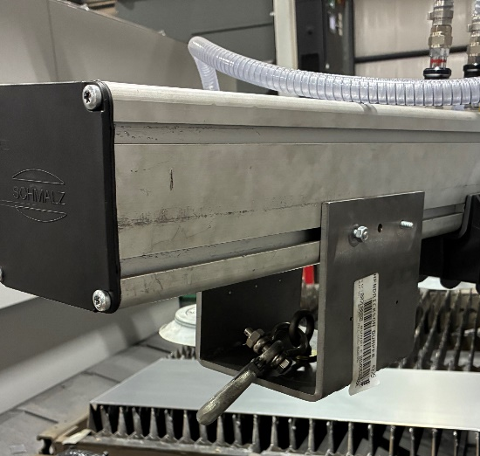
Bystronic Slat Lift
Problem: Bystronic slats degrade over time and need to be rotated out, but are very heavy and hard to move
Solution: Use vacuum lift
Worked with Ramon to design, build, and install a hook onto the vacuum lift
Now slats can be chained to lift
Time to rotate slats reduced from 3 hours to 1 hour

Slide 16
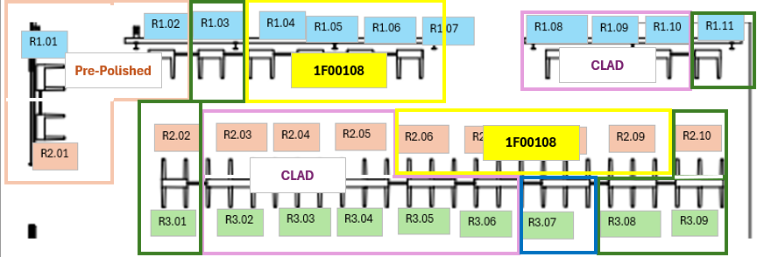
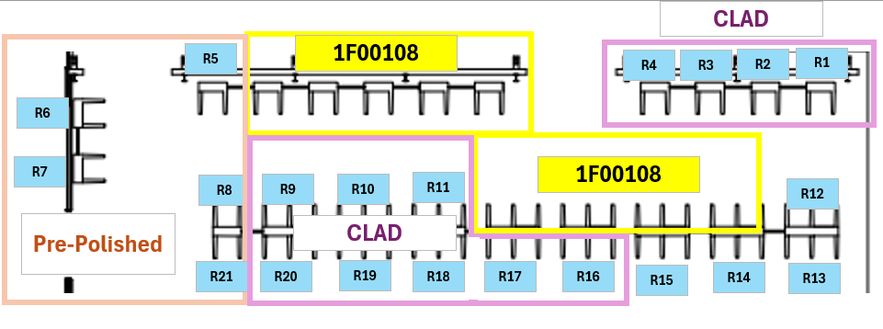
Raw Bay Reorganization
Problem: Raw bay organization was overcomplicated, and inventory was inaccurate
Solution: simplify
Shelf specific -> rack specific
Ex. R1.08.5 becomes R4
Implement audit system to prevent deterioration
Notes:
Expected process
Actual process
Why it matters – transporter sub, engineering/maintenance

Slide 17
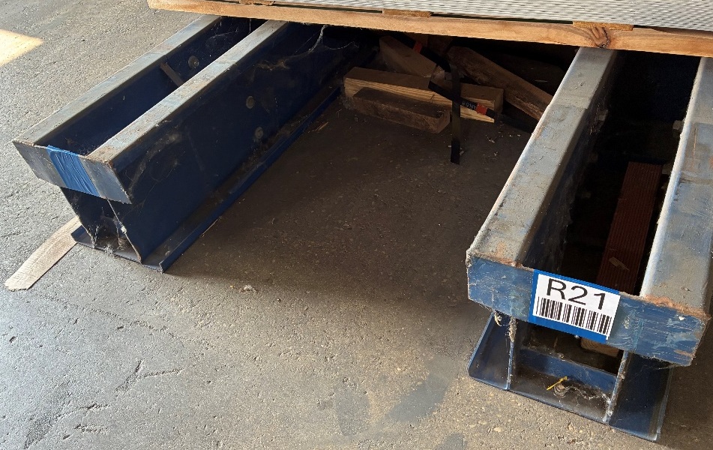
Raw Bay Reorganization
Created new labels with larger barcodes and fonts
Magnetic, allowing for easier changes
Placed new labels and working on taping over old ones with Rafay’s help
Worked with Miguel, Rafay, and Vince to move raw material to new proper place and update inventory
While updating inventory, we realized inventory was more inaccurate than we thought
Moving forward, raw bay will be audited weekly, ensuring inventory is accurate and material is easy to find
Notes:
3 prong vs 2 prong

Slide 18
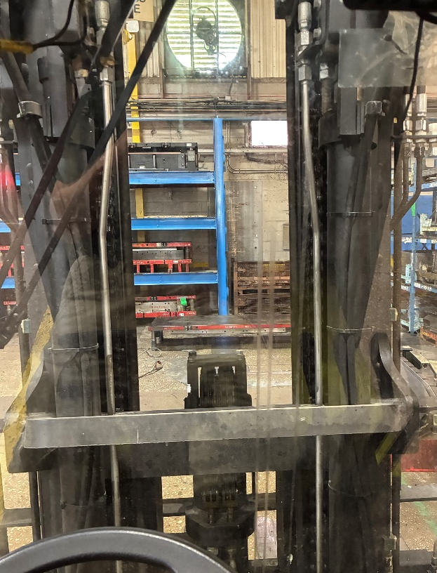
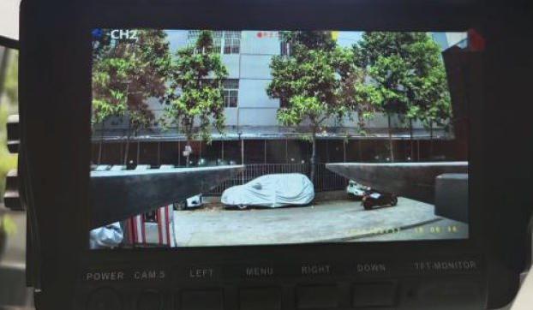
Mast Camera System
Problem: Large masts limit view in large forklifts making higher-up load movements slow and imprecise
Solution: mast camera
Like back up camera, but attaches to front of forklift at fork level

Slide 19
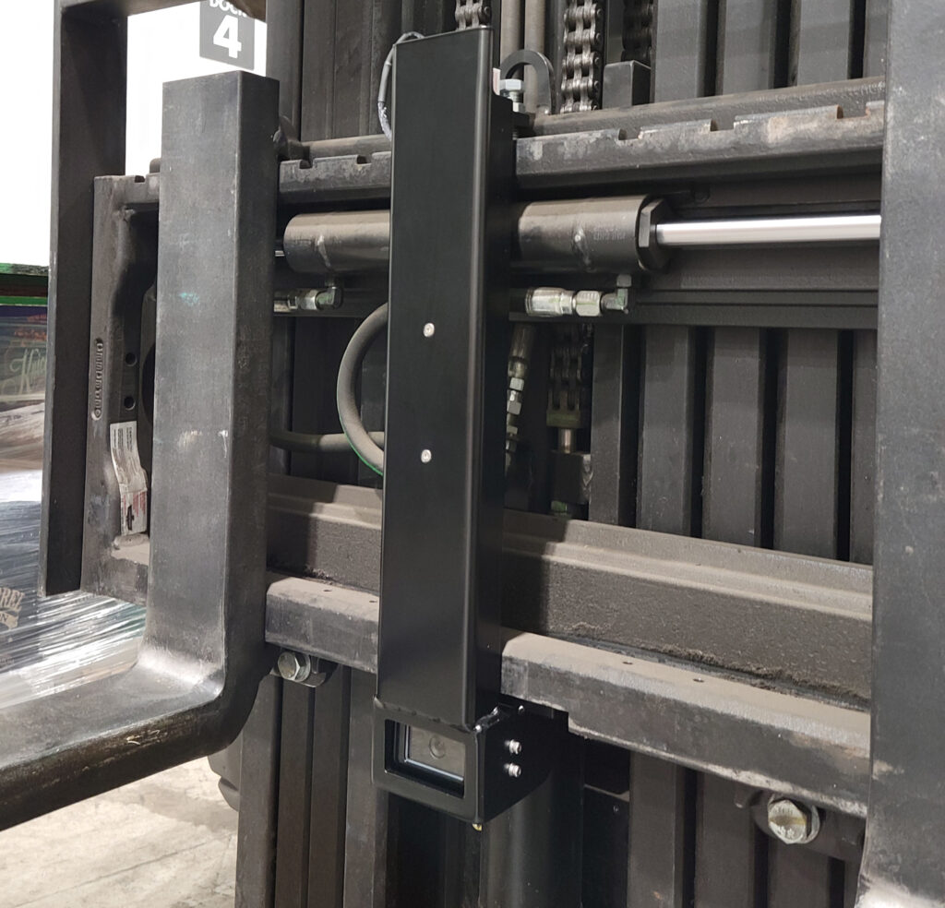
Mast Camera System - HVS
For one camera system: $2764
Comes with 7” monitor, monitor mount, camera, 6.8Ah battery, battery charger
Clarks will need 4A model, yellow forklifts will need 3A, big red not compatible
Camera comes with protective mount that bolts on like a fork
Lead time 2-3 weeks

Slide 20
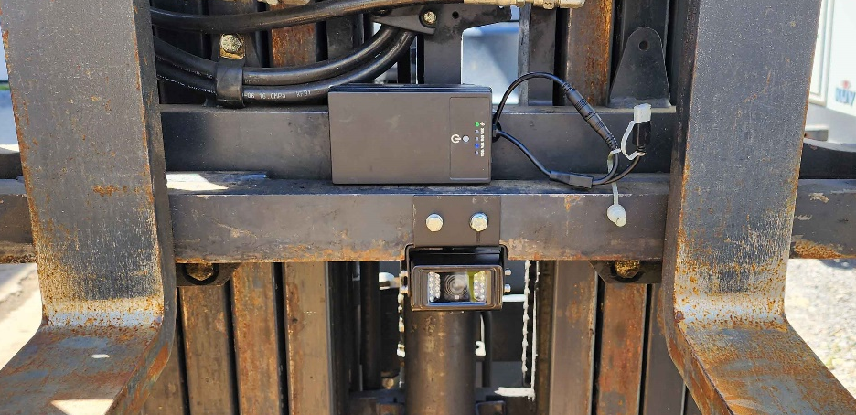
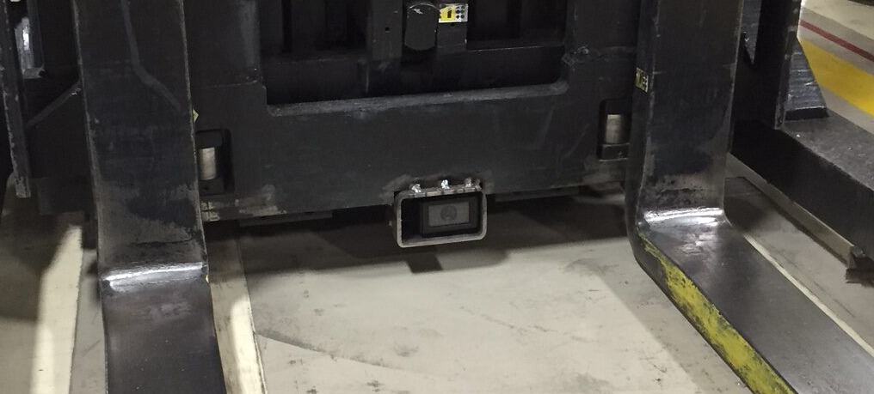
Mast Camera System - Kocchi’s
For one system: $429 + $97 for spare power bank
Comes with 7” monitor, camera, magnetic power bank
Camera bolts on to fork carriage, we would need to make a simple guard, shown bottom right
Camera connects to power bank, monitor runs on vehicle power
Lead time unknown, company based in China

Slide 21
Mast Camera System - Cost
Kocchi’s
HVS
 | Qty. | Price | Total
Big Red | 1 | $526 | $526
Green Clark | 2 | $526 | $1,052
Yellow 4-Fork | 1 | $526 | $526
Total | 4 |  | $2,104
OPTIONAL:
Yellow 2-Fork | 10 | $526 | $5,260
New Total |  |  | $7,364
 | Qty. | Price | Total
Big Red | 0 |  | $0
Green Clark | 2 | $2,764 | $5,528
Yellow 4-Fork | 1 | $2,764 | $2,764
Total | 3 |  | $8,292
OPTIONAL:
Yellow 2-Fork | 10 | $2,764 | $27,640
New Total |  |  | $35,932
Kocchi’s will require much more labor
Kocchi’s price includes a spare battery for every system, might not be necessary
HVS does not support Big Red

Slide 22
Time Studies – Press 117 Blue Bird
Recorded videos of 3-5 press cycles per part
Analyzed videos to find cycle timings accurate to 0.1 seconds
Allows for more accurate quoting and performance expectations
Also allows for accurate comparisons between press 117 and 217
Trial # | Rear Final Form | CV Blank | CV Preform | T3 Preform | T3 Final Form
Fast Approach (s) | 6.6 | 6.6 | 3.6 | 6.9 | 6.7
Press (s) | 43.9 | 8.8 | 54.8 | 37.8 | 39.8
Retract Slow (s) | 16.4 | 0.0 | 25.1 | 13.9 | 15.6
Cushion Set (s) | 6.2 | 0.0 | 1.2 | 1.2 | 1.7
Rapid Retract (s) | 7.0 | 10.3 | 8.0 | 12.3 | 14.2
Press Cycle (s) | 79.9 | 25.7 | 92.8 | 72.1 | 77.9
Material Handling (s) | 14.8 | 32.9 | 19.3 | 19.0 | 19.1
Total (s) | 94.7 | 58.6 | 112.0 | 91.1 | 97.0
Rate per hour | 38.0 | 61.5 | 32.1 | 39.5 | 37.1
Quoted rate per hour | 40.0 | 48.0 | 40.0 | 40.0 | 40.0
Efficiency vs quote | 95.0% | 128.1% | 80.3% | 98.8% | 92.8%
Notes:
Analysis process
Explain material handling

Slide 23
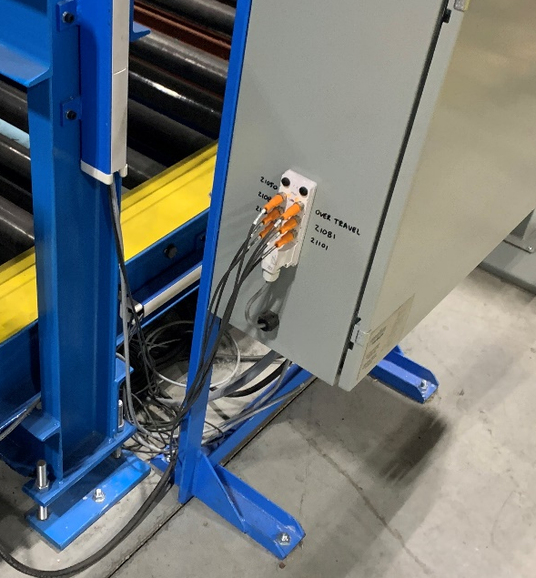
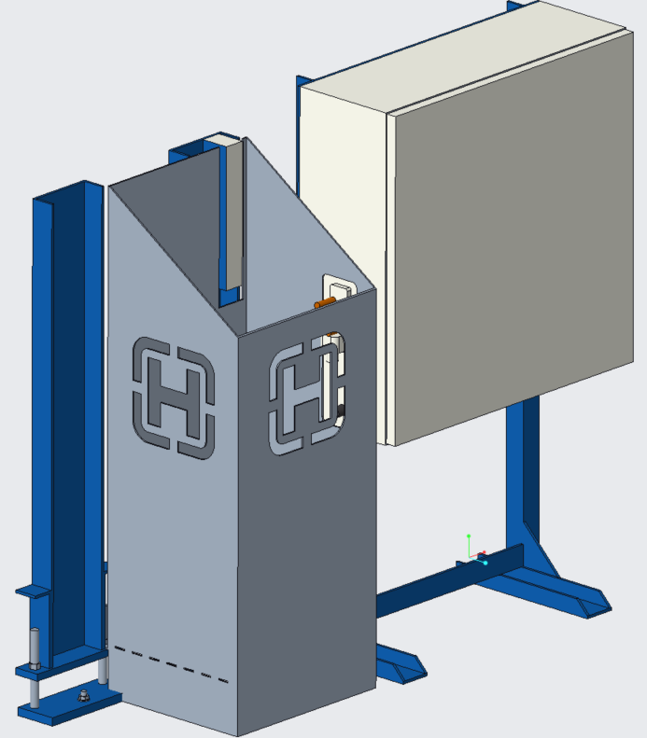
Conveyor Electrical Cover
Problem: Loose wiring exposed by the electrical cabinet at the conveyor near the Bystronic laser, which is at risk of a forklift jab
Solution: Cover it up
Modeled surrounding area, then designed a cover to protect/hide the wires while keeping them accessible
Next steps: tweak design for ease of assembly
Get some hinges to attach a top cover
Add a panel under the cabinet
Notes:
Measured surrounding area

Slide 24
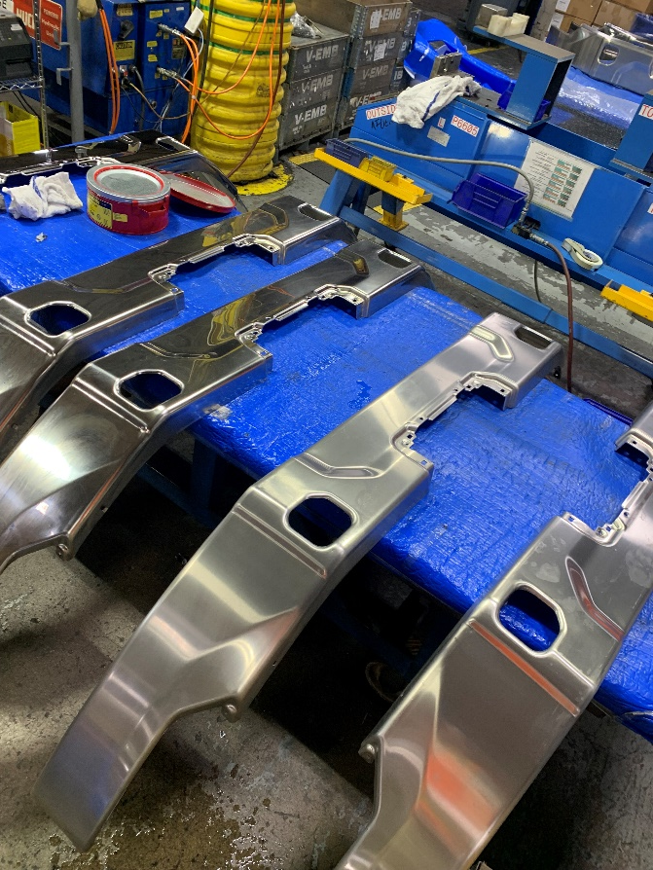
MV2 Sample Support
Assisted in the receiving, cleaning, marking, and repackaging of 30+ new Mack and Volvo samples to be shipped out for inspection

Slide 25
Takeaways
Soft skills
Interdepartmental communication
Root cause analysis
Problem solving
Project priorities
Hard skills
Welding
Creo, AutoCAD
Machinery Programming
Working with hands/tools
Microsoft Office (especially Excel)
Notes:
Future interests – thoughts on manufacturing

Slide 26
Acknowledgements
ME Team
HR
Everyone!!!

